Slide 1
EPQ Launch EPQ Delivery Team

Slide 2
EPQ offers students opportunities to:
Develop and improve your own learning and performance as critical, reflective and independent students
Develop and apply decision-making and problem solving skills
Extend your planning, research, critical thinking, analysis, synthesis, evaluation and presentation skills
Use your learning experiences to support your aspirations for further study and career development

Slide 3
Overview of the EPQ
Students are required with appropriate supervision to:
- choose an area of interest
- draft a title and aims of the project for formal approval
- plan, research and carry out the project
- deliver a presentation to a non-specialist audience
- provide evidence of all stage of project development and production for assessment

Slide 4
Course overview
Production Log
Conducting Research
Taught Element e.g. FutureLearn
Essay or Artefact
Logging everything in Journal
Presentation

Slide 5
Timeline
October 16th – Complete Initial Ideas and Candidate Proposal
November 6th – Complete Planning Review
December 18th Complete Mid-Project Review
February 5th – Start Planning your presentation
February 27th – Complete product (artefact/report)
March 11th – Presentations
March 26th – DEADLINE –submit completed project

Slide 6
EPQ sessions
Taught skills:
Time Management
Research skills and evaluation of sources
Report writing
Referencing and bibliography creation
Avoiding plagiarism
Presentation skills
Reflection and Evaluation
FutureLearn - https://www.futurelearn.com/courses/research-project
One to one’s with you EPQ tutor

Slide 7
Artefact or essay?
You will explore this in more detail with you EPQ tutor
Choice of 5000 word written report or 1000 word report plus an artefact
Artefact can be a physical outcome of your research
Book or a short film
An event such as a fashion show or musical evening
Can be anything as long as there is research at its core – clear aim that is well evaluated
Examples:
How to recreate the Aurora Borealis in a School Lab
Create an original scene for the musical ‘Wicked’
A monologue and analysis of Myra Hindley

Slide 8
Attendance
Is compulsory
Every (other) week with a register taken
Be prepared that you may have to work outside of your timetabled lesson
When working at home there will be no need to log in from home – just carry on and email if you need help

Slide 9
Fast Track EPQ students
Some students got ahead during lockdown
Therefore it is ok to complete quicker (e.g. you could finish by December)
Decision to finish EPQ early rests with your supervisor who will be the one to authorise only if every aspect of your EPQ is complete to a good standard
Presentation would still have to be done in March

Slide 10
Choosing a topic

Slide 11
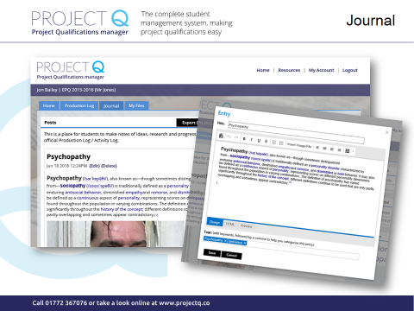
Project Q
Features
Home page
Production log
Message board
Journal
Course resources
Student Registration

Slide 12
How to register for Project Q
1) Open an Internet Browser
2) Type the web address: https://my.projectq.co
3) Click Student Register
4) Enter Course Reference: 2874
5) Enter Course Code: 03763
6) Register with your details

Slide 13
Futurelearn
You need to create a Futurelearn account and login to this course:
https://www.futurelearn.com/courses/research-project
Roughly an hour a week and you need to blog about it in your journal
You don’t need to pay for a certificate at the end – it should all be free

Slide 14
There is always something to do…
Research
Project Q
Journal
Futurelearn

Slide 15
Essentials
Everything logged on Project Q
Keep an eye on your emails
Need to bring headphones to every session
May want to bring your laptop – please bring your phone
It is all about your decision-making – record everything you do!

Slide 16
Before next time….
Enrol on Future Learn https://www.futurelearn.com/courses/research-project
Complete week 1 of FutureLearn
Enrol on Project Q https://my.projectq.co
Reflection written on Project Q Journal and also your initial ideas
Be ready to move forward with your project proposal

Slide 17
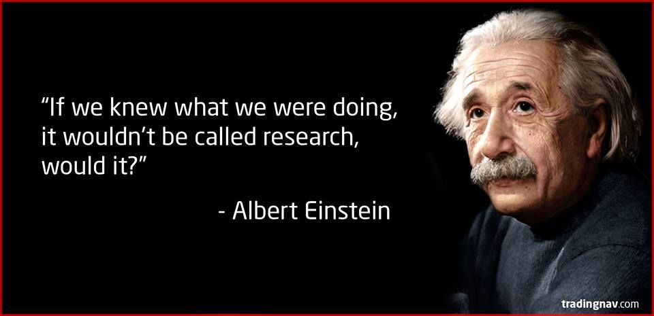
And finally…Research is messy!

