Slide 1

Welcome to
Ashton Sixth Form College
New Student
Welcome Day 2022
@ashtonsixthform
@ASFCStudentNews
2022
Notes:
Complete register and return to Reception at the end of the session

Slide 2
Today’s Session
College Information
Using College IT Systems
Using Library Learning Resources
Using Print Services
Next Steps for Students
Final Reminders
Notes:
*** best delivered by working through each slide with your student group, ensure everyone is at the same stage – there is a “mop up” slide at the end
College Info – Student timetables, tutor information
Logging onto college IT systems, using the various platforms on offer both on site and remotely
Using library systems, Canvas, click & collect, grab and go, no physical book browsing this term
How to setup your card for printing
Next steps for students
Final reminders

Slide 3
Student Cards/Lanyards
Student card/lanyard check
If you do not have a student card/lanyard, please go to the main reception straight after this session
Bring to your card to college every day! If you forget it, you must go to main Reception. Don't share a card with a friend.
Notes:
Student card and lanyard check: Any students without a student card should go to Main Reception after the session but before they leave college today.

Slide 4

Notes:
Outline behaviour for learning expectations

Slide 5
Student Timetables: A Level/ Mixed Study
Example A level/mixed study timetable
Notes:
Student timetables and explain how they work, including:
Times of each period/lesson
Teacher’s name and subject
The room number
Morning break
Use of study periods/study day
Group tutorial and 1:1 tutor support periods

Slide 6
Student Timetables: L3 FT Vocational
Example Level 3 full time vocational timetable
Notes:
Student timetables and explain how they work, including:
Times of each period/lesson
Teacher’s name and subject
The room number
Morning break
Use of study periods/study day
Group tutorial and 1:1 tutor support periods

Slide 7
Student Timetables
5 periods in a day (70 mins per session)
P1 9:00 – 10:10
Break 10:10 – 10:30
P2 10:30-11:40
P3 11:40 – 12:50
P3 12:30 – 1:40
(Lunch will be 50 mins in either one of these 2 periods)
P4 1:40 – 2:50
P5 2:50 – 4:00
Any gaps are independent study periods

Slide 8
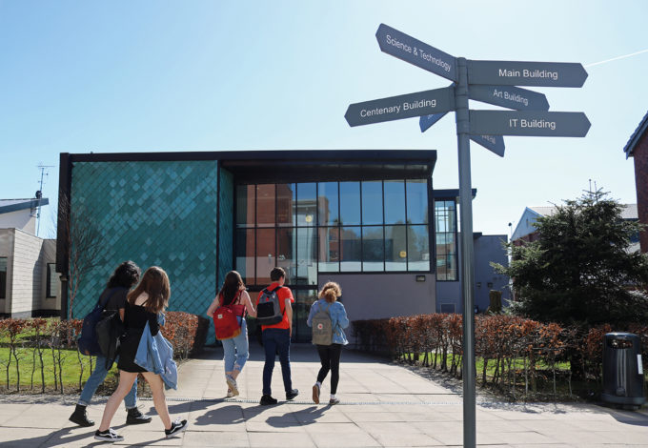
Student Timetables
MB – Main Building
GH – Geoff Higgins
C – Centenary
ST – Science and Technology
AD – Art and Design
HE – Higher Education rooms
IT – IT rooms
L – Sports rooms
Portakabin – 2 Portakabin buildings outside of the perimeter fence

Slide 9
Student Timetables
Timetables will be available from Weds 7th Sept (pm) on Cedar
All lessons are compulsory
All Group Tutorials are compulsory
1:1 Tutor Support – only attend if asked to by your Senior Tutor
Study+ sessions can be added to your timetable if you are behind with work, underachieving or have missed lessons
Study Days are for study! You will be asked to come in if behind on work/ underachieving or have missed lessons

Slide 10

Reporting Absences
Parent/carer/guardian to report absence wherever possible:
Absence line – 0161 330 2330
ASFC Parent Cedar
Sign out for students – Main Reception in college (to be authorised asap by parent/ carer/ guardian)
Holidays are always marked as an unauthorised absence
Notes:
Covid absence guidelines tbc

Slide 11

Over to You
Now we will be logging onto all the college network accounts you will need during your time at college
Please remember your password!
We will also show you how to access these systems from home

Slide 12
How to set up your network login/password
Your login details are made of the following:
Example username: 22smithjohnp
The default password is: Password1 (once you initially login you will be prompted to choose a new password of your choice)
Your password should consist of 8 or more characters and should include 3 of the following 4 types:
English uppercase (A through Z)
English lowercase (a through z)
Digits 0 through 9
Non-alphabetic characters e.g. !%&
Email Address: 22smithjohnp@asfc.ac.uk
Year of enrolment | Surname | First name | Middle initial
22 | smith | john | p
Notes:
Get them to sign in and change their password – Complex passwords needed – Probably the most complicated task of the day!
Staff – you will have a list of usernames
This is your College network logon. Sign in change your password and get to the desktop
Year - Surname - Firstname - Middle initial if they have one…. (usernames can get a bit complicated if students have long, multiple names).
If there are any problems they can visit the IT helpdesk – MB 2.19

Slide 13
Wi-Fi Access on your device
The College network is ASFC-BYOD
Login with your College username and password
If you need help getting onto the Wi-Fi please see a member of Library or IT staff (IT helpdesk: MB 2.19)
Notes:
The network you need to connect to is ASFC-BYOD – the others will not work.
If you need help logging onto the network please visit the Library or IT Help desk.

Slide 14
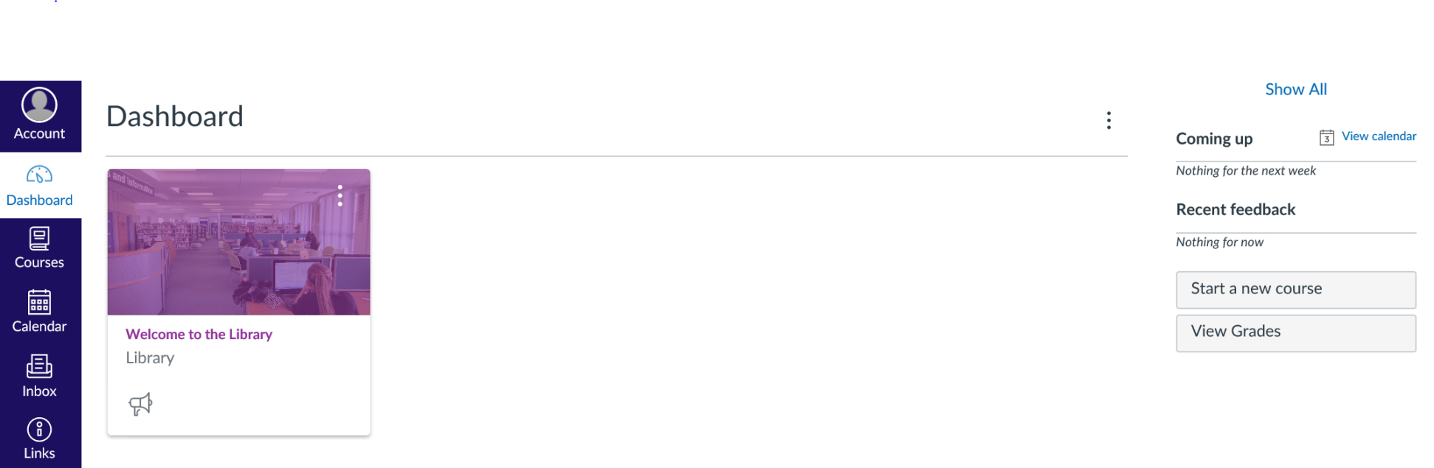
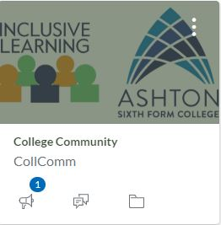
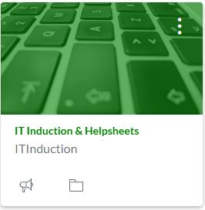
Internet: Your VLE Homepage – Canvas
Here you will see upcoming assignments and tasks for your courses
Download the student Canvas App – instructions available in IT Induction and Help Sheets tile
You will find College support services including Inclusive Learning, the Chaplaincy, Exams, Learner Voice, etc. in the College Community tile
Notes:
Your VLE homepage in College – Open Google Chrome! Canvas is where you will access most of your subject materials. Your chosen courses will be visible when you log onto Canvas alongside some other tiles including Library Services, IT Induction & Helpsheets, and the College Community. The College Community is where you will find College information and updates, extra curricular activities and important college support services including Inclusive Learning, Exams, Learner Voice, and more.
Very important that you check Canvas everyday and get familiar with it – there is a free Canvas mobile app available from the App store.
You may have some time today to download the App. It is an external website and therefore accessible anywhere not just in college – links on the main ASFC website.

Slide 15
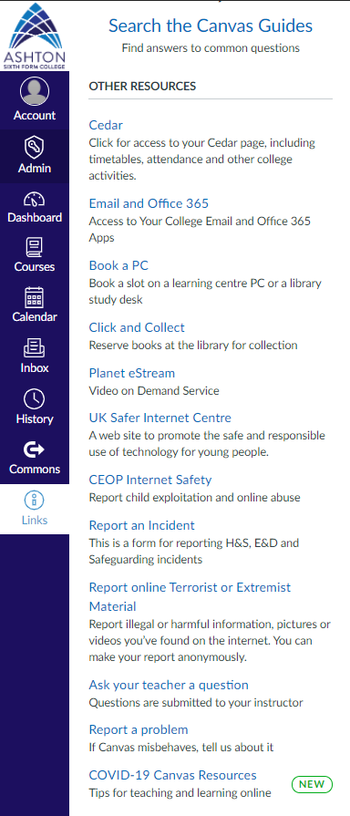
Links
Cedar
Click here to check your emails daily
Book a PC in the Library or IT Centre
Library Click and Collect
eStream Video on demand service
Report an incident
Ask your teacher a question
Report a Canvas problem
Tips for COVID learning
Notes:
From the Links icon (on the left) you can access more important College services including Cedar, your college student email and your Office 356 apps (Word, PowerPoint, etc.).
Link to Cedar – PURPLE ARROW – access timetable, attendance info, etc.
Link to college student email – GREY ARROW – check daily
If you are concerned about something, or need to report an incident you can do this from here – Health and safety, safeguarding, equality & diversity, terrorist materials, etc. – BLUE ARROWS
You can send a message to your teacher – click on “Ask your teacher a question” On Canvas ‘instructor’ means your teacher.
Ask your teacher a question – this will send them an email – GREEN ARROW
If Canvas is not working or there is a problem with it, you can report it via this link – RED ARROW

Slide 16

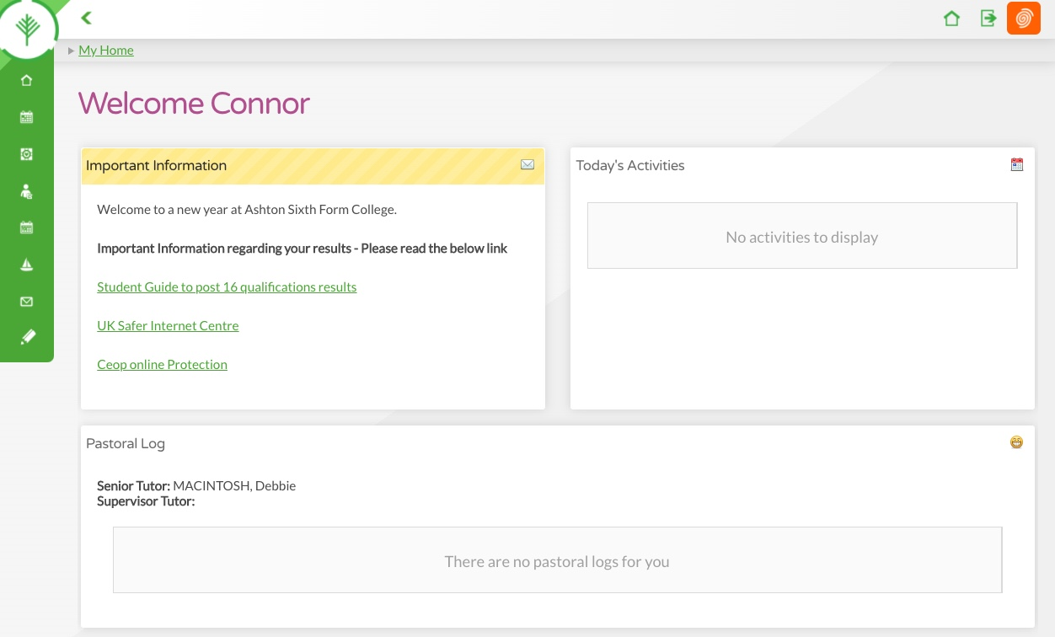
https://cedar.asfc.ac.uk
Cedar is the college system that provides information on…
Your timetable
Your contact details
Attendance/absences
Progress on your programme of study (formal assessment points)
Achievements
Exam info/timetables
Careers planning
Surveys
Notes:
Cedar is the college system that helps students track progress in their subjects, attendance/absences, timetable/exams info, surveys, careers planning, etc. It is accessible in college and outside college on mobile devices. Access with your college username and password.
Run Google chrome from the task bar at the bottom, go to Cedar using the address above or via the menu in Canvas. You can also get to Cedar from the college web page at www.asfc.ac.uk Have a look around your Cedar page
Students will get their timetable this way so important that they check it!!
Use the address above or the link at the bottom of the ASFC website – book mark it in your phone! Try to get students to do this in this session

Slide 17
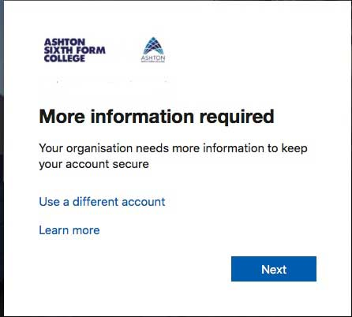
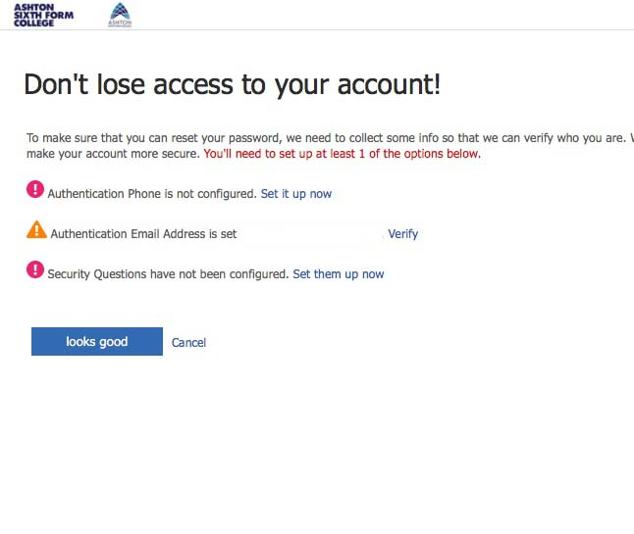
MS Office Verification
The first time Office 365 is accessed you will be asked to provide an alternative method of contact.
Click on Next
Here you can pick any one of the options available. Authentication phone is the most popular method.
If you have your phone with you select the first option to receive a text and confirm your identity.
Once completed you can use this method to reset your password in the future should you need to.

Slide 18

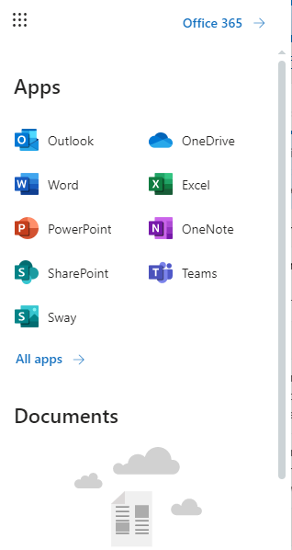
College Student Email
Access your college email via the following…
College PC Desktop Canvas
Office 365
Your teachers/Senior Tutor will communicate regularly with you via this email
Pin important messages/email to the top of your inbox
Use the search box at the top to find specific emails/messages from your teachers/Senior Tutor
Create folders to move read important emails that you would like to keep
Use emails professionally – use polite and respectful language and have realistic expectations of when a member of staff may reply
You MUST check your college email daily!
Notes:
Read through the points on this slide and demo if needs be
This is really important info as this will be how teachers/Senior Tutors communicate with students especially remotely!

Slide 19
Office 365
Office 365 applications are accessible from anywhere via the office.com website
You can also download the apps for your mobile device
Use your college email address and password to sign in
You can download free copies of MS Office onto your own computer at home.
Notes:
In college access to Office 365 is via an icon on your desktop. Outside of college you can get access via the office.com website
Double Click on the Office 365 icon on your desktop – the first time you access Office 365 you will be asked to supply a mobile phone number to help you in the future should you forget your password.
Click on the Apps Icon to show the available applications
Click on One Drive
Instructions on downloading a free copy of Office for your home device available via Library/IT Office or Canvas.

Slide 20
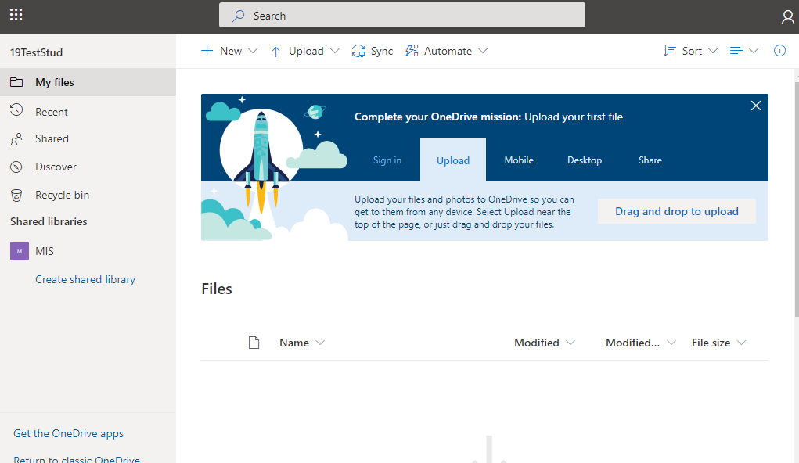
OneDrive
1 TB of free storage from any device
Pen drives are restricted in some areas!
Accessible from Canvas, your VLE
Notes:
Students can upload data to the cloud and use it from any device, both in college and from home: Please reinforce the advice to use One Drive to store docs.
Integrates into Canvas which we will look at later

Slide 21
Student Acceptable User Policy: College computer network,
Email, Internet and Remote Working
Click on the IT Induction & Helpsheets tile on Canvas
Please read and agree to the Student Acceptable User Policy
Notes:
You need to adhere to the student acceptable user policy when using college IT equipment, the college network (e.g. email, file saving, using the internet on a PC), Wi-Fi, social media and remote working. Remember, college email is not the same as your personal email.
Please note that PCs and laptop usage is monitored.
This is all covered in the Student Acceptable User Policy which you need to read carefully via the IT Induction tile on Canvas and follow throughout your time at ASFC. Please encourage students to read and agree to the Student Acceptable User Policy in this session.

Slide 22

Remote Services
All links to college systems are available at the bottom of the ASFC website https://www.asfc.ac.uk/
Here you can access Email, Canvas, Cedar and Remote Desktop services
All are web based and accessible outside college using these links.
Notes:
Ask the students to go to www.asfc.ac.uk on their mobile device and bookmark it. Show them the links at the bottom that take them directly to services (sometimes google searching takes them to the incorrect Cedar or Canvas website).
Remote desktop should only be used to access college network drives all other services are direct web links not best used via remote desktop.

Slide 23
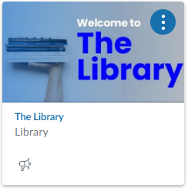

Library Homepage
The Library’s homepage is where you can access online resources, library news and contact information.
There are links to subject guides which tell you about your library resources
There are two Learning Facilitators based in the Library to support you in your independent learning
Use the search engine to find resources.
Notes:
You all have access to the Library Homepage - this is where you can access lots of online resources, library news, Twitter and contact information for your Learning Facilitator – every course has a dedicated information specialist who can help you to find your course textbooks and how to research.
There are also links to subject guides which tell you all about the info we have for your course.
It’s important to use some high quality, academic information in your coursework and think critically about what you read. The Library can help you with this.
You may be having a subject specific library induction where you will meet your Learning Facilitator in the next few weeks – or look out for them in the Library or Library IT Centre.

Slide 24
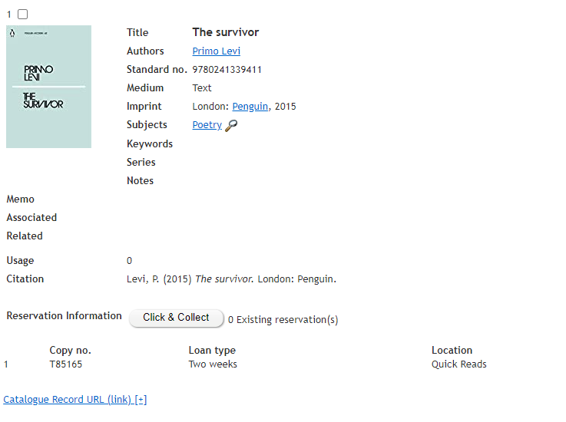
Loaning Library Resources
Click and Collect will allow you to reserve a book for collection from the library system.
Notes:
Click and Collect – choose a book via the library system in Canvas and we will have it ready for your collection.

Slide 25
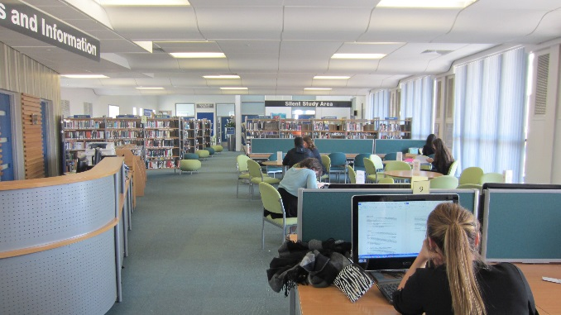
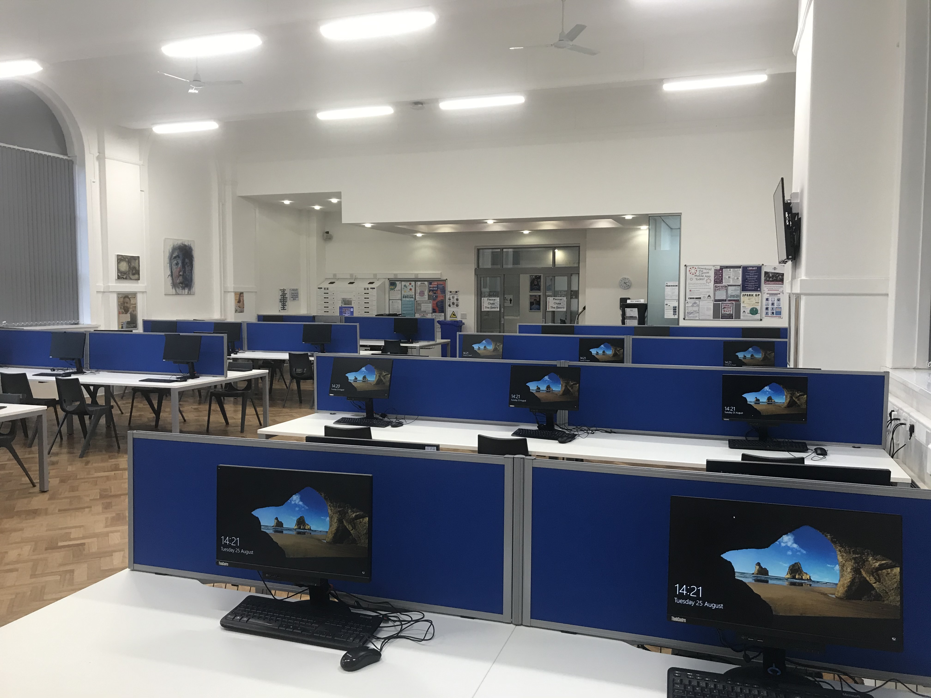
Learning Centres
The Learning Centres are for study; they are not social spaces.
The Library in the Geoff Higgins building is a silent zone, please respect the space.
PCs in the Library and Library IT Centre can be booked in 10 – 70 minute slots via a link on Canvas
Library – GH2.5
Library IT Centre – Main Building 1st Floor
Notes:
There are two learning centres available for students to study – reinforce that these are NOT social spaces. We will be operating a 2 strikes warning procedure where after 2 warnings you would be asked to leave and not be allowed to use the centres for two weeks.
Library –the Library is in the Geoff Higgins building on the 1st Floor and is a silent zone. Please respect other users of the library spaces in college.
Library IT Centre – in the main building with 55 fixed PCs. The PCs can be booked in 1 hour slots via a link in Canvas. This room will sometimes be used for online exams and therefore not accessible.

Slide 26
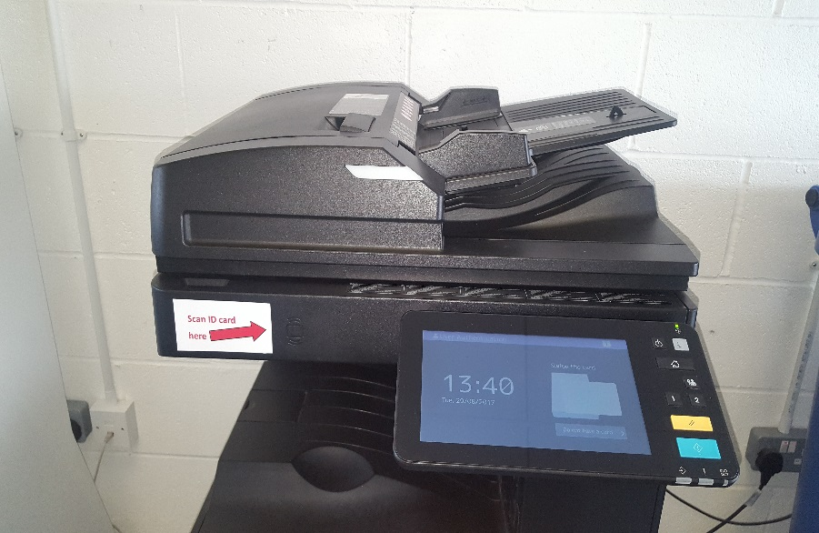
Printing Services
Printers are located in the corridors throughout College and in the Learning Centres. These can print, scan and photocopy.
You can use any printer and you will need your card to release the print. Register using your College username and password once.
You will receive print credits per term.
Type | Cost
A4 Mono | 2p
A4 Colour | 8p
A3 Mono | 6p
A3 Colour | 16p
Notes:
After this session you will need to go and find a printer in college and register.
All you need to do is scan your card and enter your college network username and password – which you will now have. You only need to register once – after you’ve done this you simply scan your card to access your printing account.
You can send a job to print and collect it from any printer in college – it does not have to be the closest printer and your job will stay on the printer network for 24 hours. All students (apart from Art students) have a £10 per term printing allowance. Art students have a £20 allowance

Slide 27

Social Media
Twitter Feeds:
@ashtonsixthform
@ASFCStudentNews
@asfclibrary
Instagram:
@asfclibrary
@ashtonsixthformcollege
Notes:
Main communications will be via email but there are a number of social media feeds to follow – some examples above. Please encourage students to follow ASFCStudentNews in particular
There is also an ASFCNewsflash for students with important info/updates about opportunities both in/outside of college, e.g. realising aspirations, careers/employability, mental health and well being, etc.

Slide 28
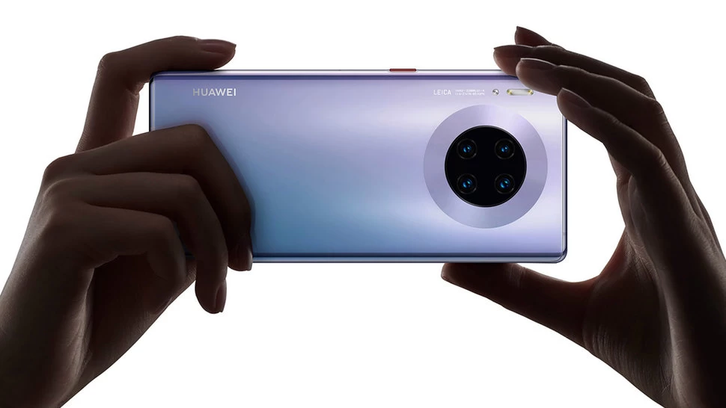
Things to Remember
Login with your Username and Password.
  Username = 22surnamefirstnamemiddleinitial
  Default password = Password1
Reset the default password to your own.
Read and accept the Student Acceptable User Policy on Canvas.
Bookmark Cedar https://cedar.asfc.ac.uk on your mobile.
Bookmark https://www.asfc.ac.uk/ on your mobile.
Download the Canvas Student app to your mobile.
Learning Centre spaces are study spaces
Register your student card at any printer in College.
Always sign off the PC when you have finished with it.
If you are applying for the college bursary and/ or free college meals, please submit your application ASAP
Help on all the above is available
from the IT Induction & Help Sheet tile on Canvas
Notes:
The main tasks to complete or to take away from todays session are displayed above. Take a photo
Help on all the above is available from the IT Induction & Help Sheet tile on Canvas

Slide 29

Next Steps…
Weds 7th September (pm): Monitor college email to find out when your timetable is ready to view in Cedar
Staff available in college Main Reception to answer any timetable queries
Notes:
Talk through slide, reiterating the points highlighted in red.

Slide 30
Final Reminders
If you have not yet had your photo taken, you must go to Main Reception before you leave today
Info from today’s session available under College Community tile (Canvas) under Tutorials
Period 1 lessons start at 9am on Thurs 8th Sept. Tutorials will start from Mon 12th Sept
Remember to wear your Student Card/Lanyard at all times; if you forget, you will have to report to the Main Reception (off Darnton Road)
Notes:
Talk through slide
If any students did not have a student card, there is a good chance we do not have their photo so please send them to main reception

Slide 31
Good luck with your studies!
Remember college staff are here to help ☺
Library email: learningcentre@asfc.ac.uk
IT Support email: techsupport@asfc.ac.uk

Slide 32

Any Questions?

